Slide 1
Shell Scripting Fundamentals
- Hidayathulla M.A [ Emp id : 542902 ]

Slide 2
What is a Shell?
Shell is a command interpreter.
It is the layer between the operating system kernel and the user.
Shells provide a "command line" interface which allows the user to enter commands which are translated by the shell into something the kernel can comprehend and then is sent off to the kernel for it to act upon.
Shell gets started when the user logs in or start the terminal.
Usually shells are interactive that mean , they accept command as input from users and execute them.

Slide 3
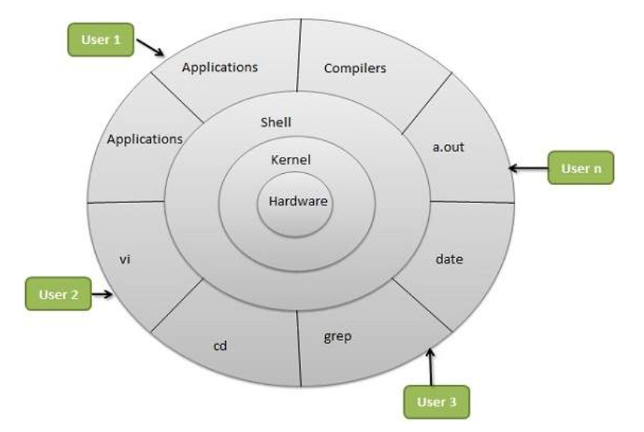
OS Architecture

Slide 4
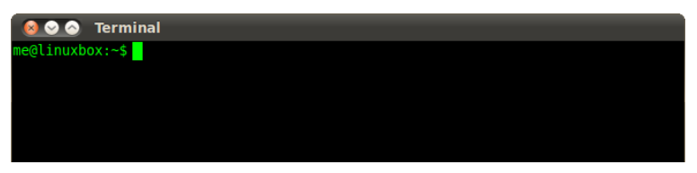
Shell Prompt
The prompt, $, which is called the command prompt, which is displayed by the shell. While the prompt is displayed, you can type a command.
Shell reads your input after you press Enter. It determines the command you want executed by looking at the first word of your input.
A word is an unbroken set of characters. Spaces and tabs separate words.
The command prompt looks something like this:

Slide 5
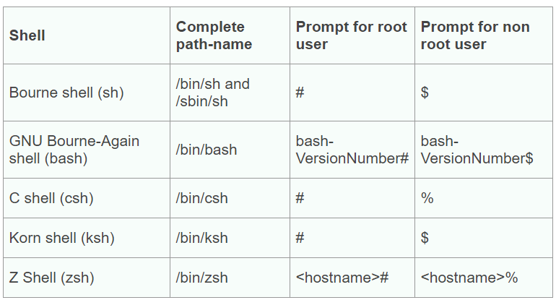
Shell Types
There are different types of shells available. Lets see some of these :

Slide 6
What is a Kernel?
A Kernel is a computer program that is the heart and core of an Operating System. Since the Operating System has control over the system so, the Kernel also has control over everything in the system.
It is the core interface between a computer’s hardware and its processes.
The sole aim of kernel is to manage the communication between the software (user level applications) & hardware (CPU, disk, memory etc) which is done through system calls.

Slide 7
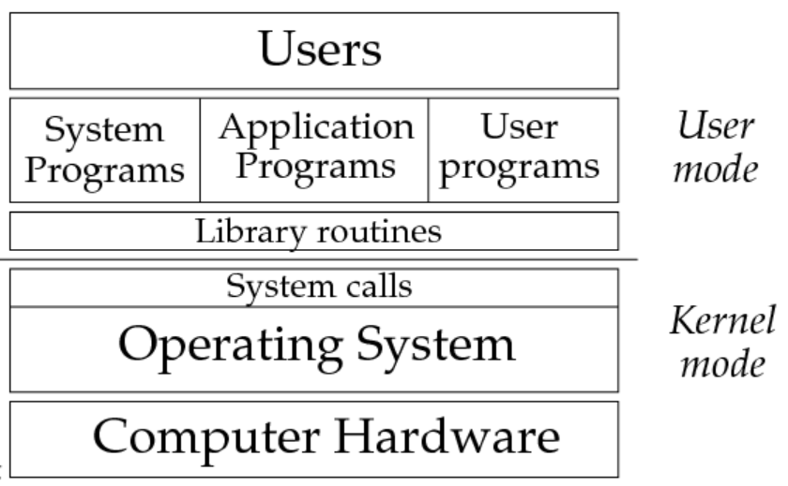

Slide 8
File Management
All data in Unix/Linux OS is organized into files.
ls command : To list the files and directories stored in the current directory.
The -l ( lowercase L) option tells ls to print files in a long listing format.When the long listing format is used, you can see the following file information:
The file type
The file permissions.
Number of hard links to the file.
File owner.
File group.
File size.
Date and Time.
File name.

Slide 9
Contd…
Hidden files – ls –a
Creating/Editing files – vi , cat, touch,
Copying files - cp
Renaming files - mv
Deleting files - rm

Slide 10
File permissions & Access modes
Below are the attributes of files on unix/linux boxes :
Owner permissions − The owner's permissions determine what actions the owner of the file can perform on the file.
Group permissions − The group's permissions determine what actions a user, who is a member of the group that a file belongs to, can perform on the file.
Other (world) permissions − The permissions for others indicate what action all other users can perform on the file.
Access modes : (same for both files & directories)
Read (4)
Write (2)
Execute (1)
You can use “chmod” command to change the permissions of files/directories.
For Eg : chmod 755 <file_name>

Slide 11
Process management
A process, in simple terms, is an instance of a running program.
The operating system tracks processes through a five-digit ID number known as the pid or the process ID. Each process in the system has a unique pid.
Starting a Process
When we start a process (run a command), there are two ways we can run it −
Foreground Processes
Background Processes
Foreground Processes
By default, every process that we start runs in the foreground. It gets its input from the keyboard and sends its output to the screen.

Slide 12
Contd…
Background Processes
A background process runs in the background without being connected to the keyboard.
The advantage of running a process in the background is that we can run other commands as we do not have to wait until it completes to start another.
The simplest way to start a background process is to add an ampersand (&) at the end of the command.
For Eg : <command/script_name> &

Slide 13
Listing running process
“ps” (Process Status) command is used to list the currently running processes and their PIDs along with some other information depends on different options.
Syntax –
ps [options]
The output of ps command is as follows
$ ps
PID TTY STAT TIME CMD
5140 pts/4 Ss 00:00:00 bash
61244 pts/4 R+ 00:00:00 ps
PID - the number/id of the process
TTY - the name of the console that the user is logged into
TIME- the amount of CPU in minutes and seconds that the process has been running
CMD - the name of the command that launched the process

Slide 14
Contd…
Stopping Processes
To stop a process , we can make use of “kill” command.
Syntax :
Kill -9 <pid>

Slide 15
Shell Scripts
A shell script is basically a set of commands that the shell in an operating system follows.
A shell script consists of following elements :
Shell Keywords - if, else, break etc.
Shell Variables
Shell Commands – cd, ls, cat, vi, touch, etc.
Functions
Control flow – if…then…else, case, other looping statements

Slide 16
Why do we need shell scripts?
To avoid repetitive work and automation.
System admins use shell scripting for taking routine backups & snapshots.
System monitoring
Customizing administrative tasks.
Adding new functionality to the shell etc.

Slide 17
Invoking a shell script
The first line must be “#!/bin/bash”.
setup the shell path
chmod +x scriptname
./scriptname
If you have to run the script with different shell, lets say ksh
/bin/ksh ./scriptname

Slide 18
Shell and Environment variables
Local Variables : A local variable is a variable that is present within the current instance of the shell. It is not available to programs that are started by the shell. They are set at the command prompt.
Shell Variable : A shell variable is specific to the shell itself and is not inherited by child processes. For example, let's say you're running another application from the shell, that application will not inherit the shell variable.
Environment Variable : Environment variables are inherited by all child processes.
Environment variables can be persistent, whereas, for shell variables once you exit the session, they're all gone.
Environment variables have UPPER CASE and shell variables have lower case names.
To access the value stored in a variable, prefix its name with the dollar sign ($).

Slide 19
Special variables
$0 - The filename of the current script.
$# - The number of arguments supplied to a script.
$* - All the arguments are double quoted. If a script receives two arguments, $* is equivalent to $1 $2.
$@ - All the arguments are individually double quoted. If a script receives two arguments, $@ is equivalent to $1 $2.
$? - The exit status of the last command executed.
$$ - The process number of the current shell. For shell scripts, this is the process ID under which they are executing.
$! - The process number of the last background command.

Slide 20
Arrays
An array is a systematic/ordered arrangement of the same type of data. But in Shell script Array is a variable which contains multiple values may be of same type or different type since by default in shell script everything is treated as a string. An array is zero-based ie indexing start with 0.
There are different ways we declare arrays basing on the type of shell we use.
For eg: set -A array_name value1 value2 ... valuen // In Ksh
You access array variable as follows - ${array_name[index]}
refers to all the elements of the array - ${array_name[@]} or ${array_name[*]}
get a count of the number of elements in an array - ${#array_name[@]} or ${#array_name[*]}

Slide 21
Operators
Various operators supported by shell are :
Arithmetic Operators
Relational Operators
Boolean Operators
String Operators
File Test Operators

Slide 22
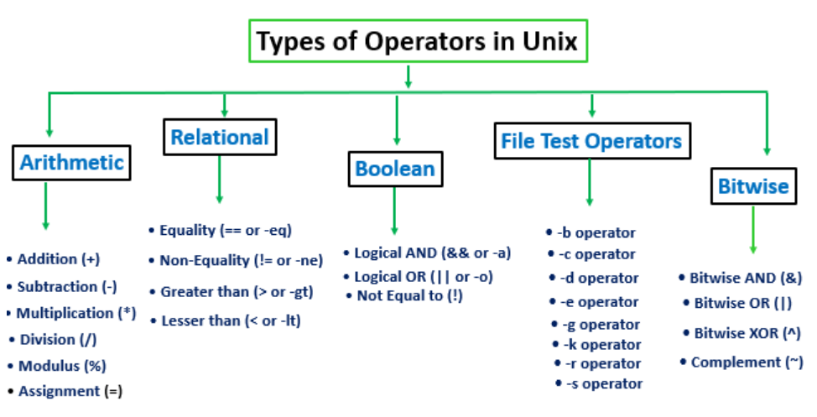

Slide 23
Conditional statements
The if...else statement : There are different ways we can write an if…else statement
Syntax :
if [ expression ]
then
Statement(s) to be executed if expression is true
fi
-----------------------------------------------------------------------------------------------
if [ expression ]
then
Statement(s) to be executed if expression is true
else
Statement(s) to be executed if expression is not true
fi

Slide 24
if [ expression 1 ]
then
Statement(s) to be executed if expression 1 is true
elif [ expression 2 ]
then
Statement(s) to be executed if expression 2 is true
elif [ expression 3 ]
then
Statement(s) to be executed if expression 3 is true
else
Statement(s) to be executed if no expression is true
fi

Slide 25
The case...esac statement :
case word in
pattern1)
Statement(s) to be executed if pattern1 matches
;;
pattern2)
Statement(s) to be executed if pattern2 matches
;;
pattern3)
Statement(s) to be executed if pattern3 matches
;;
*)
Default condition to be executed
;;
esac

Slide 26
Loops
Loop is a programming tool that enables us to execute a set of commands repeatedly.
while statement
for statement
until statement
To alter the flow of loop statements, two commands are used they are :
break → It is used to exit the current loop.
continue → It is used to exit the current iteration of a loop and begin the next iteration

Slide 27
while command
do
Statement(s) to be executed if command is true
done
for var in word1 word2 ... wordN
do
Statement(s) to be executed for every word.
done
until command
do
Statement(s) to be executed until command is true
done

Slide 28
I/O Redirection
> - Redirects stdout to a file, Creates the file if not present, otherwise overwrites it
< - Accept input from a file.
>> - Creates the file if not present, otherwise appends to it.
<< - Forces the input to a command to be the shell’s input, which until there is a line that contains only label.
| - pipe, similar to ">",

Slide 29
File Descriptor
A file descriptor is a number that uniquely identifies an open file in a computer's operating system.
It describes a data resource, and how that resource may be accessed.
file descriptor :
0 is standard input (STDIN),
1 is standard output (STDOUT), and
2 is standard error output (STDERR)
Discard the output
Sometimes you will need to execute a command, but you don't want the output displayed on the screen. In such cases, you can discard the output by redirecting it to the file /dev/null −
$ command > /dev/null
Here command is the name of the command you want to execute. The file /dev/null is a special file that automatically discards all its input.
To discard both output of a command and its error output, use standard redirection to redirect STDERR to STDOUT −
$ command > /dev/null 2>&1

Slide 30
Here Document
A here document is used to redirect input into an interactive shell script or program.
We can run an interactive program within a shell script without user action by supplying the required input for the interactive program, or interactive shell script.
The general form for a here document is −
command << delimiter
document
Delimiter
#!/bin/sh
cat << EOF
This is a simple lookup program
for good (and bad) restaurants
in Cape Town.
EOF

Slide 31
Functions
Function is a reusable block of code.
Functions enable us to break down the overall functionality of a script into smaller, logical subsections, which can then be called upon to perform their individual tasks when needed.
Shell functions are similar to subroutines, procedures, and functions in other programming languages.
Declare function :
function_name () {
list of commands
}
or
function function_name {
list of commands
}

Slide 32
Returning Values from Functions
return command is used to exit from a shell function. It takes a parameter [N], if N is mentioned then it returns [N] and if N is not mentioned then it returns the status of the last command executed within the function or script.
N can only be a numeric value.
Syntax: return [N]
When a function ends its return value is its status: zero for success, non-zero for failure & the status value is stored in the $?
If you use exit command with in the functions , it will exit the entire program code, Hence it is not suggested to use this command with in functions where as return command with just exit the function.

